Slide 1

Dr.H.N.Sinha Arts and Commerce College, Patur Dist-Akola
Inauguration
Dr.V.N.Jayle
Our Lovely & Respectively
Principal
Presented by. Dr.Ronil K. Ahale

Slide 2
Dr.H.N.Sinha Arts and Commerce College, Patur Dist-Akola
WelCome
Dr.M.J.Ingole
(Coordinator Commerce Dept.)
Prof.H.A.Ekbote
Dr.R.K.Ahale
Presented by. Dr.Ronil K. Ahale

Slide 3
Dr.H.N.Sinha Arts and Commerce College, Patur Dist-Akola
Welcome
B.Com I
Presented by. Dr.Ronil K. Ahale

Slide 4
Index
1.Computer Organisation-
2-Block Diagram of Computer-
3-Input & Output Device.
4-Microsoft Word-
5-Starting M S Word 2007.
6- Formating Document-
7- Header & Footer.
8.Computer Organisation-
9.Block Diagram of Computer-
Presented by. Dr.Ronil K. Ahale

Slide 5
Practical No-01
Name of Practical -: Computer Orgaisation
Aim:- Block Diagram of Computer-
Elements of Digital Computer %&
1. Central Processing unit CPU
2. Input Device
3. Output Device
The architecture of computers differs from one system model to another However basic organization remains the same for all computer system. The following figure shows a block diagrame of basic computer organization.
Presented by. Dr.Ronil K. Ahale

Slide 6
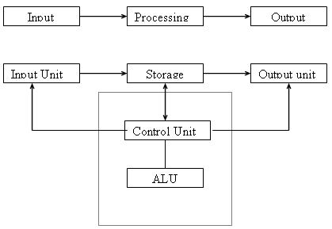
BLOCK DIAGRAM OF COMPUTER
Practical No-02
Presented by. Dr.Ronil K. Ahale

Slide 7
All computer perform the following basic operations for converting raw input data into usefull information and presenting it to the user.
Practical No-02
Five basic operations performed by computer are
Inputting
Storing
Processing
Outputting
controlling
Presented by. Dr.Ronil K. Ahale

Slide 8
Practical No-02
INPUT UNIT
Computers need to receive data and instruction in order to Solve
Any Problem. Therefore we need to input the data and Instructions
into the computers. The input unit consists of one or more input
devices.
Keyboard is the one of the most commonly used input device.
Other commonly used input devices are the mouse, floppy disk
drive, magnetic tape, etc.
All the input devices perform the following functions.
Accept the data and instructions from the outside world.
Convert it to a form that the computer can understand.
Supply the converted data to the computer system for further
processing.
Presented by. Dr.Ronil K. Ahale

Slide 9
Storage Unit
Practical No-02
The storage unit of the computer holds data and instructions that are entered through the input unit, before they are processed.
It preserves the intermediate and final results before these are sent to the output devices.
It also saves the data for the later use.
The various storage devices of a computer system are divided into two categories.
1. Primary Storage: Stores and provides very fast.
This memory is generally used to hold the program being currently executed in the computer, the data being received from the input unit, the intermediate and final results of the program.
The primary memory is temporary in nature. The data is lost, when the computer is switched off.
Presented by. Dr.Ronil K. Ahale

Slide 10
Practical No-02
In order to store the data permanently, the data has to be transferred to the secondary memory.
The cost of the primary storage is more compared to the secondary storage.
Therefore most computers have limited primary storage capacity.
2. Secondary Storage:
Secondary storage is used like an archive.
It stores several programs, documents, data bases etc.
The programs that you run on the computer are first transferred to the primary
memory before it is actually run.
Whenever the results are saved, again they get stored in the secondary memory.
The secondary memory is slower and cheaper than the primary memory.
Some of the commonly used secondary memory devices are Hard disk, CD, etc.,
Presented by. Dr.Ronil K. Ahale

Slide 11
Practical No-02
Memory Size
All digital computers use the binary system, i.e. 0’s and 1’s. Each character or a number is represented by an 8 bit code.
The set of 8 bits is called a byte.
A character occupies 1 byte space.
A numeric occupies 2 byte space.
Byte is the space occupied in the memory.
The size of the primary storage is specified in KB (Kilobytes) or MB (Megabyte). One KB is equal to 1024 bytes and one MB is equal to 1000KB.
The size of the primary storage in a typical PC usually starts at 16MB.
PCs having 32 MB, 48MB, 128 MB, 256MB memory are quite common.
Presented by. Dr.Ronil K. Ahale

Slide 12
Practical No-02
Output Unit
The output unit of a computer provides the information and results of a computation to outside world.
Printers, Visual Display Unit (VDU) are the commonly used output devices.
Other commonly used output devices are
floppy disk drive,
hard disk drive,
magnetic tape drive.
Presented by. Dr.Ronil K. Ahale

Slide 13
Arithmetic Logical Unit
Practical No-02
All calculations are performed in the Arithmetic Logic Unit (ALU) of the computer.
It also does comparison and takes decision.
The ALU can perform basic operations such as addition, subtraction, multiplication, division, etc and does logic operations like, >, <, =, ‘etc.
Whenever calculations are required, the control unit transfers the data from storage unit to ALU, once the computations are done, the results are transferred to the storage unit by the control unit and then it is send to the output unit for displaying results.
Presented by. Dr.Ronil K. Ahale

Slide 14
Control Unit
Practical No-02
It controls all other units in the computer.
The control unit instructs the input unit, where to store the data after receiving it from the user.
It controls the flow of data and instructions from the storage unit to ALU.
It also controls the flow of results from the ALU to the storage unit.
The control unit is generally referred as the central nervous system of the computer that control and synchronizes its working.
Presented by. Dr.Ronil K. Ahale

Slide 15
Central Processing Unit
Practical No-02
The control unit and ALU of the computer are together
known as the Central Processing Unit (CPU).
The CPU is like brain performs the following functions:
• It performs all calculations.
• It takes all decisions.
• It controls all units of the computer.
A PC may have CPU-IC such as Intel 8088, 80286, 80386, 80486, Celeron, Pentium, Pentium Pro, Pentium II, Pentium III, Pentium IV, Dual Core, and AMD etc .
Presented by. Dr.Ronil K. Ahale

Slide 16
Practical No-03
INPUT OUTPUT DEVICES
A computer system needs to communicate with its external environment its user). The Input/output devices provide this capability to a computer system.
Presented by. Dr.Ronil K. Ahale

Slide 17
INPUT DEVICE
Practical No-03
Input devices are used to enter data from outside world into primary storage & output devices supply the result of processing from primary storage to users.
Input device is any peripheral (piece of computer h/w equipment) used to provide data & control signals to an information processing system. Input/output devices make up the h/w interface between a computer .
Presented by. Dr.Ronil K. Ahale

Slide 18
The most common input devices are following.
Practical No-03
Keyboard
Mouse
Scanner
Joystick
Presented by. Dr.Ronil K. Ahale

Slide 19
KEYBOARD
Practical No-03
The keyboard is the main input device for computers. For instance, boot up a computer without a keyboard and it stops, warning the user that no keyboard is attached.
The keyboard is the only tool available at the command prompt, so it is a necessity for a computer.
It is also used in almost every application like spreadsheets, email, word processing documents and coding.
Presented by. Dr.Ronil K. Ahale

Slide 20
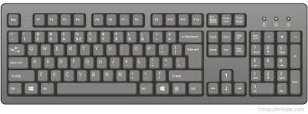
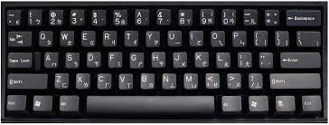
Practical No-03
Presented by. Dr.Ronil K. Ahale

Slide 21
Practical No-03
.
It is possible to interact with most computers solely through the keyboard, without even a mouse, because they are usually the default input device. Touch screens may eventually overcome the keyboard as well, by providing an onscreen keyboard to save space.
The keyboard is the most common input device. It is almost unheard of for a computer to be without some form of keyboard, be it a full QWERTY keyboard or a smaller number pad, such as those found on a cell phone
Presented by. Dr.Ronil K. Ahale

Slide 22
Mice and other Pointing devices
Practical No-03
Other than the keyboard, mice are the most common type of input device.
Nearly every computer has one, and they make navigating the screen much easier than trying to use just a keyboard.
Mice usually use a ball, light, or a laser to track movement.
Similar peripherals, such as a touch screen or laptop's touchpad, trackballs, graphics tablets, and even joysticks are “pointing” input devices.
Touch screens are becoming an increasingly popular pointing device, and someday may replace mice altogether.
Presented by. Dr.Ronil K. Ahale

Slide 23

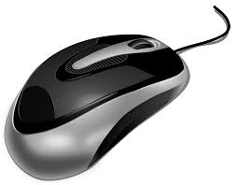
Practical No-03
Presented by. Dr.Ronil K. Ahale

Slide 24
scanner
Practical No-03
Scanners allow information such as a photo or text to be input into a computer.
Scanners are usually either A4 size (flatbed), as shown below, or hand-held to scan a much smaller area.
If text is to be scanned, you would use an Optical Character Recognition (OCR) program to recognize the printed text and then convert it to a digital text file that can be accessed using a computer.
Presented by. Dr.Ronil K. Ahale

Slide 25
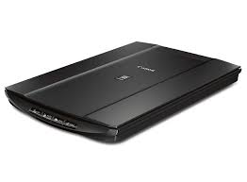
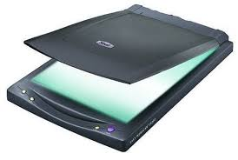
Practical No-03
Presented by. Dr.Ronil K. Ahale

Slide 26
CD-ROM
Practical No-03
Short for Compact Disc-Read Only Memory, CD-ROM drives are CD players inside computers that can have speeds in the range from 1x and beyond, and have the capability of playing audio CDs and computer data CDs.
Presented by. Dr.Ronil K. Ahale

Slide 27
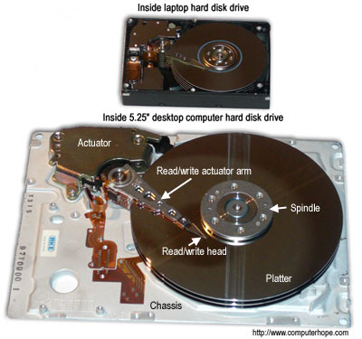
Practical No-03
Below is a picture of the front and back of a standard CD-ROM drive.
Presented by. Dr.Ronil K. Ahale

Slide 28
Output device
Practical No-03
An output device is any piece of computer hardware equipment used to communicate the results of data processing carried out by an information processing system (such as a computer) to the outside world.
Presented by. Dr.Ronil K. Ahale

Slide 29
Practical No-03
In computing, input/output, or I/O, refers to the communication between an information processing system (such as a computer), and the outside world.
Inputs are the signals or data sent to the system, and outputs are the signals or data sent by the system to the outside.
Presented by. Dr.Ronil K. Ahale

Slide 30
Examples of output devices:
Practical No-03
Speaker
Headphones
Screen (Monitor)
Printer
Presented by. Dr.Ronil K. Ahale

Slide 31
speaker
Practical No-03
Computer speakers, or multimedia speakers, are speakers external to a computer, that disable the lower fidelity built-in speaker.
They often have a low-power internal amplifier.
Computer speakers range widely in quality and in price.
The computer speakers typically packaged with computer systems are small, plastic, and have mediocre sound quality. Some computer speakers have equalization features such as bass and treble
Presented by. Dr.Ronil K. Ahale

Slide 32
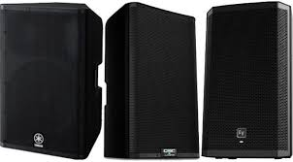
Practical No-03
Presented by. Dr.Ronil K. Ahale

Slide 33
Headphones
Practical No-03
Headphones are a pair of small loudspeakers, or less commonly a single speaker, with a way of holding them close to a user's ears and a means of connecting them to a signal source such as an audio amplifier, radio or CD player.
They are also known as stereo phones, headsets.
The in-ear versions are known as earphones or ear buds.
In the context of telecommunication, the term headset is used to describe a combination of headphone and microphone used for two-way communication, for example with a telephone.
Presented by. Dr.Ronil K. Ahale

Slide 34

Practical No-03
Presented by. Dr.Ronil K. Ahale

Slide 35
Monitor
Practical No-03
A Monitor or Display (sometimes called a visual display unit) is an electronic visual display for computers.
The monitor comprises the display device, circuitry, and an enclosure.
The display device in modern monitors is typically a thin film transistor liquid crystal display (TFT-LCD) thin panel, while older monitors use a cathode ray tube about as deep as the screen size.
Presented by. Dr.Ronil K. Ahale

Slide 36
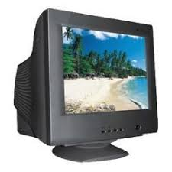
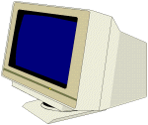
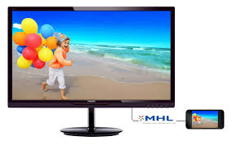
Examples of Output Devices
Practical No-03
Monitor
This is the most common output device.
ICT Tools: Output Devices
Presented by. Dr.Ronil K. Ahale

Slide 37
Screen Features
Practical No-03
Size
Desktop screens are usually 14 – 19 inches by diagonal measurement. (This is how TV screens are measured, too.) Larger sizes are available, at a significantly higher cost.
Resolution
Determines how clear and detailed the image is.
Pictures on a screen are made up of tiny dots.
1 dot on screen = 1 pixel. The more pixels per inch, the clearer and more detailed the picture.
ICT Tools: Output Devices
Presented by. Dr.Ronil K. Ahale

Slide 38
Type of Screens
Practical No-03
Monochrome
One colour text on single colour background, i.e. white letters on blue, or green characters on black.
Colour
Various colours can be displayed.
Liquid Crystal Display
(LCD)
Used in laptops especially.
Plasma Screens
Used for very large screens and some laptops.
ICT Tools: Output Devices
Presented by. Dr.Ronil K. Ahale

Slide 39
Practical No-03
Printers
Impact Printers
Non-Impact Printers
Daisy
wheel
Dot-
Matrix
Inkjet
Thermal
Laser
Presented by. Dr.Ronil K. Ahale

Slide 40
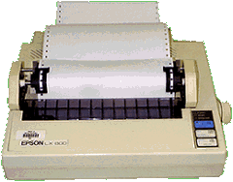
“Dot Matrix Printer”
Practical No-03
The term dot matrix refers to the process of placing dots to form an image.
Its speed is usually 30 to 550 characters per second (cps).
This is the cheapest and the most noisy printer and has a low print quality. Dot Matrix were 1st introduced by Centronics in 1970.
Presented by. Dr.Ronil K. Ahale

Slide 41
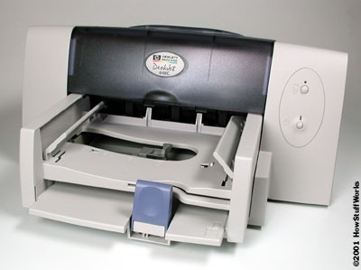
“Ink-Jet Printer”
Practical No-03
It is a non-impact printer producing a high quality print. A standard Inkjet printer has a resolution of 300dpi. Newer models have further improved dpi. Inkjet printers were introduced in the later half of 1980s and are very popular owing to their extra-ordinary performance.
Presented by. Dr.Ronil K. Ahale

Slide 42
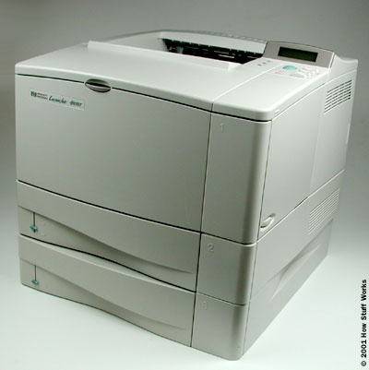
“Laser Printer”
Practical No-03
Laser printers use very advanced technology and produce a high quality output. Laser printers can also produce high quality graphics images.
Resolution is 600 to 1200dpi.
Presented by. Dr.Ronil K. Ahale

Slide 43
“Multi-function printer”
Practical No-03
A multi function printer abbreviated as MFP is an all purpose device that prints, faxes, copies and scans. A single multi function printer can replace several bulky devices. These printers use inkjet technology and provide high quality print but at slow speed.
Presented by. Dr.Ronil K. Ahale

Slide 44

Microsoft Word 2007
Introduction to Word Processors
Practical No-04
Presented by. Dr.Ronil K. Ahale

Slide 45

What is Microsoft Word 2007?
Practical No-04
Microsoft Word 2007 is a word processor created by Microsoft, and is included in the Microsoft Office 2007 software suite.
Presented by. Dr.Ronil K. Ahale

Slide 46
Starting Microsoft Word
Practical No-04
You may start Microsoft Word by locating the Microsoft Office shortcut folder, and selecting the Microsoft Word shortcut.
Note: The location of this shortcut will vary depending upon your chosen configuration and installation settings. However, it will most commonly be located in a “Microsoft Office” folder created during the program installation.
Presented by. Dr.Ronil K. Ahale

Slide 47
Getting Started with Word Processors
Practical No-04
Word processors offer you the flexibility to format documents by making changes to the font, the page layout, and the page style.
Presented by. Dr.Ronil K. Ahale
Notes:
A word processor provides the functionality of various components, such as paper, pen, typewriter, eraser, and a dictionary. Most computers have preinstalled word processors. Some examples of basic word processors are Notepad and WordPad.
All word processors offer you the flexibility to format documents by making changes to the font, the page layout, and the page style.
You can also use advanced word processors, such as Word, to perform complex tasks such as checking for wrong spellings, finding synonyms, inserting graphics, printing documents, and displaying documents in multiple on-screen windows.

Slide 48

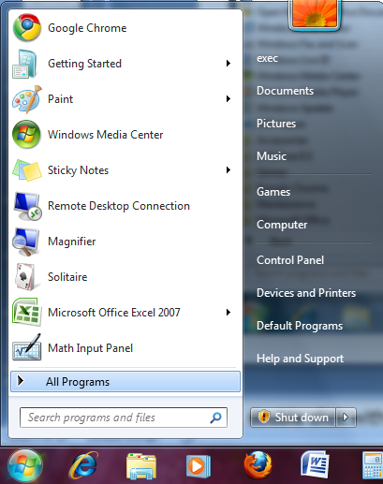
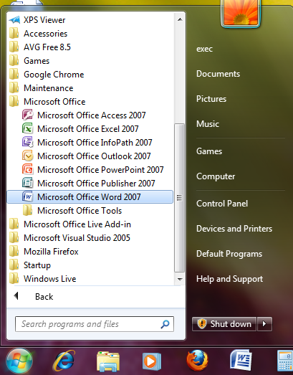
Getting Started with Word Processors
Practical No-04
You can open Microsoft Word by clicking on the desktop icon…
… or by clicking the START button.
Presented by. Dr.Ronil K. Ahale
Notes:
To open Word, double click with the left mouse button on the Microsoft Word icon.
OR click Start, point to All Programs, point to Microsoft Office, and then click Microsoft Office Word 2003.

Slide 49
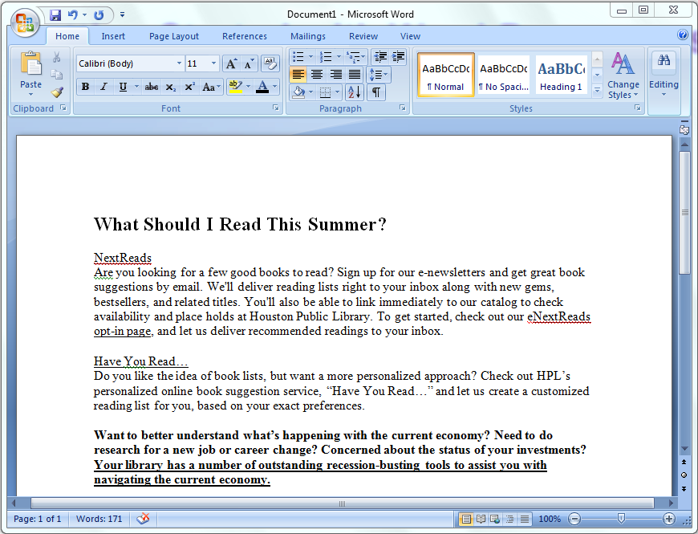
Getting Started with Word Processors
Practical No-04
When you see the cursor blinking, you are ready to type. Otherwise, use your mouse to click anywhere on the white part of the page.
Presented by. Dr.Ronil K. Ahale

Slide 50
Lesson Objectives
Practical No-04
After completing this lesson, you will be able to:
Perform basic tasks in a word processor.
Edit and format text.
Work with tables and pictures.
Work with language tools.
Presented by. Dr.Ronil K. Ahale
Notes:
Word processors are specialized programs that allow you to change the look and feel of a text document. These programs include tools that help you to create documents by inserting graphics, charts, tables, and other media elements. These programs also help you to create a variety of business and personal documents such as reports, resumes, and letters.
In this lesson, you will learn about the basic tasks that you can perform by using a word processor. You will learn to work with text, tables, and pictures.

Slide 51
Navigating within a Document
Practical No-04
Use your mouse to click anywhere that you have typed text.
You can use the arrow keys on your keyboard to move the cursor vertically or horizontally.
The HOME key moves the cursor to the beginning of the line.
The END key will take it to the end of the line.
Presented by. Dr.Ronil K. Ahale
Notes:
You can use different methods to navigate within a document.
Use your mouse to click anywhere that you have typed text.
Remember that you can use the scroll bar on the right side of the window to view more sections of your document.
You can use the arrow keys on your keyboard to move the cursor vertically or horizontally.
To move the insertion point to the beginning of the document, hold down the CTRL key, press the HOME key, and then release the CTRL key.
To move the insertion point to the beginning of the line, press the HOME key.
To move the insertion point to the end of the line, press the END key.
To move the insertion point to the end of the document, hold down the CTRL key, press the END key, and then release the CTRL key.

Slide 52
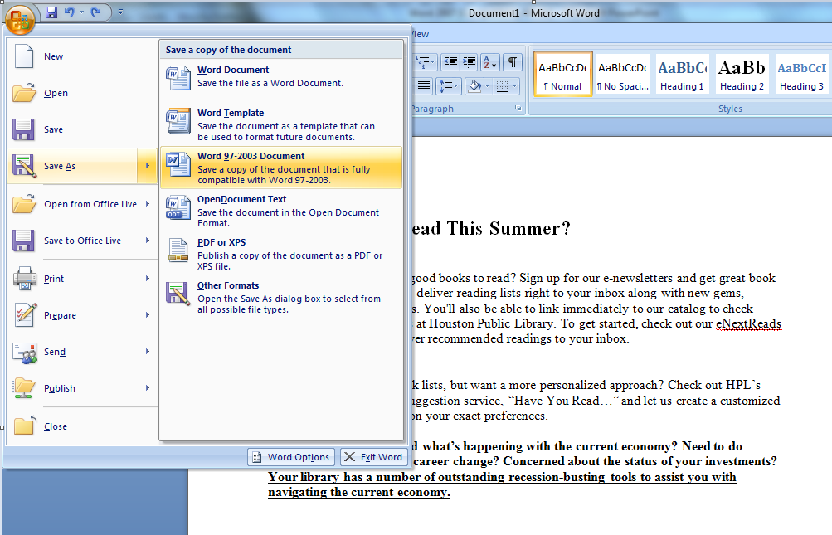
Saving a File
Practical No-05
To save the document, click the Save button on the Quick Access Toolbar or click on the Office Button to choose how to save the file.
Office Button
Quick Access Toolbar
Presented by. Dr.Ronil K. Ahale
Notes:
After creating the document, you want to save it so that you can find it again, and so you don’t lose any of the changes you make.
To save the document, on the Standard toolbar, click the Save button, as indicated. The icon on it looks like a little hard disk.
To select the folder in which the document should be stored, in the Save As dialog box, double-click the folder labeled School of Fine Art.
To change the file name to Announcement Guidelines from the default file name, in the File name box, select School of Fine Art, and then type in the new title. To finish saving the file, in the Save As dialog box, click Save.

Slide 53
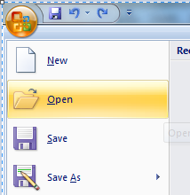
Opening an Existing File
Practical No-05
On the Standard toolbar, click the Open button.
In the Open dialog box, double-click the name of the document you want to open.
Presented by. Dr.Ronil K. Ahale
Notes:
To open an existing document, on the Standard toolbar, click the Open button– the icon looks like an opening folder.
Then, in the Open dialog box, double-click the Sales Report document.
Note: You can have multiple documents open at the same time. However, only one document window remains active at one time.
To view a list of the files open in Word, click the Window menu. You can switch between files by clicking on the title of the file you want to work on.
You can also close the active document without closing Word.
At the right corner of the menu bar, click the Close Window button.
Notice that this appears underneath the buttons that will minimize, resize, and close the Program window.

Slide 54
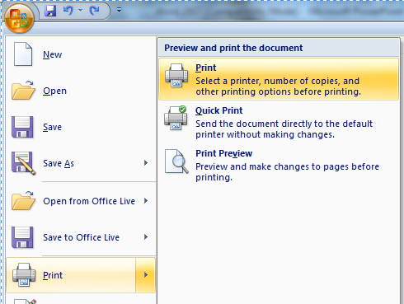
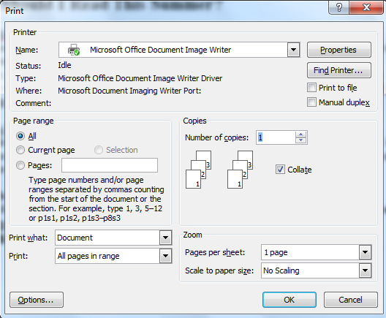
Printing Your File
Practical No-05
To print out your document click on the Office Button, and then click Print.
This prints one copy of your file using the default settings.
When you need to, you can modify the settings of your print job in the Print dialog box.
Presented by. Dr.Ronil K. Ahale
Notes:
You want to print copies of the Announcement Guidelines document and distribute it to your colleagues. To print one copy of the Announcement Guidelines document by using the default settings of your printer, click the File menu, and then click Print.
The Print dialog box includes details about the name of the printer, range of pages, and the number of copies to be printed. You can modify these details to suit your requirements.
To print four copies of this document, under Copies in the Print dialog box, double-click in the Number of copies box, and then press SPACEBAR to have the text typed for you.
Then, to print the current document with the custom settings, in the Print dialog box, click OK.

Slide 55
Editing and Formatting Text
Practical No-05
Advanced word processors include special tools that help you easily edit and format documents.
Word processors can:
  cut, copy, and paste text
  undo and redo actions
  justify or re-align text
  change font parameters
  change paragraph spacing
  various other editing and formatting functions.
Presented by. Dr.Ronil K. Ahale

Slide 56

Copy + Paste
Practical No-05
Select
Hold down the left mouse button and drag the cursor OR
Hold down SHIFT and use the arrow keys on the keyboard.
Copy
You can find the Copy and Paste commands under the Home Tab.
Paste
You can also copy and paste by clicking with the
right mouse button on a word you have selected
to pull up a shortcut menu.
Presented by. Dr.Ronil K. Ahale
Notes:
To start making changes to your document, you must first select the text before making any formatting or editing changes.
Selecting text is easy. You can use the mouse or the keyboard to select a word, a sentence, a paragraph, or even the entire document.
To select text using the mouse, move the insertion point to the space right before the text you want to select.
Hold down the left mouse button—don’t let go!– while you drag the cursor over the text you want to select.
You can use the copy and paste features provided in Word. This feature helps you duplicate information and reuse it in another part of the same document, in a different document, or in a different program. Copying text does not change the actual location of the original text. You can copy by clicking the Copy button on the standard toolbar.
After copying the text, you can use the paste feature to insert text or a graphic that has been cut or copied from one document into a different location in the same or a different document. You can use the Paste button on the standard toolbar to paste text or graphics.

Slide 57
Cut + Paste
Practical No-05
Using Cut + Paste is like moving text from one location to a new one.
The cut command is located :
in the Home Tab
or in a shortcut menu when you right-click on a selected word
Presented by. Dr.Ronil K. Ahale
Notes:
You now want to move a portion of the document from one location and place it in a different location. For this, you can use the cut and paste feature. Unlike the Copy function, the Cut function removes the original text from the source.
The computer can ‘remember’ the text that you have cut, even though it is deleted from the screen.
You then paste the cut text into its new location using the Paste button.

Slide 58

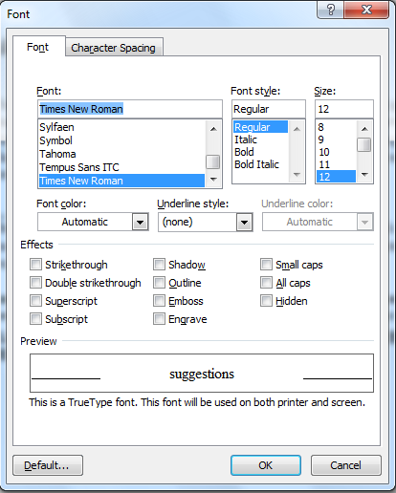
Formatting Text
Practical No-06
In the Font dialog box, you can make changes to the type, style, size, and color of font used in the document.
Size
Font
You can change the “handwriting” of your text.
Font style
Put a word in bold or italics for emphasis.
Effects
Will let you add underlining, shadows, or details like strikethrough.
Presented by. Dr.Ronil K. Ahale
Notes:
The Format menu includes options to change Font, Paragraph, and other style options.
In the Font dialog box, you can make changes to the type, style, size, and color of font used in the document.
Make sure you have selected the text you want to change before you try to format it.
The Preview area allows you to view the text when making these changes.

Slide 59
Formatting Text
Practical No-06
Font
Size
Color
Many of these text options can also be found on your Home Ribbon in the Font Group.
Presented by. Dr.Ronil K. Ahale
Notes:
The Format menu includes options to change Font, Paragraph, and other style options.
In the Font dialog box, you can make changes to the type, style, size, and color of font used in the document.
Make sure you have selected the text you want to change before you try to format it.
The Preview area allows you to view the text when making these changes.

Slide 60

Alignment
Practical No-06
You can specify the arrangement of objects, text, and graphics, in predetermined positions using the alignment settings.
You can align the selected text to the left, right, or center by using the left, right, and center alignment buttons.
Presented by. Dr.Ronil K. Ahale
Notes:
You can specify the arrangement of objects, text, and graphics, in predetermined positions using the alignment settings. You can align the selected text to the left, right, or center by using the left, right, and center alignment buttons, respectively.
You now want to change the alignment of text in the document. You can use the Justify button to fit the text of a paragraph evenly between the left and right margins of a page. Note that when applying paragraph formatting, you can simply place the insertion point anywhere in the paragraph instead of selecting the entire paragraph.
You can adjust the paragraph spacing in the Paragraph dialog box to make the text easily readable. You can also increase or decrease the line spacing within the paragraph. This also helps make the text easily readable.

Slide 61
Bullets and Numbering
Practical No-06
You can use the bullet or numbering options to organize information into lists.
Bullets |  | Numbering
 | Aardvark Butterfly Cactus Daffodil |  | Aardvark Butterfly Cactus Daffodil
Presented by. Dr.Ronil K. Ahale

Slide 62
Indenting and Spacing
Practical No-06
Use indentation to
  offset text away from
    the margin or bring it
closer again.
Presented by. Dr.Ronil K. Ahale

Slide 63
Undoing Mistakes
Practical No-06
Sometimes, you want to reverse the last action you performed. For this, you can use the Undo button:
Similarly, you can use the Redo button to repeat the last action:
Presented by. Dr.Ronil K. Ahale

Slide 64
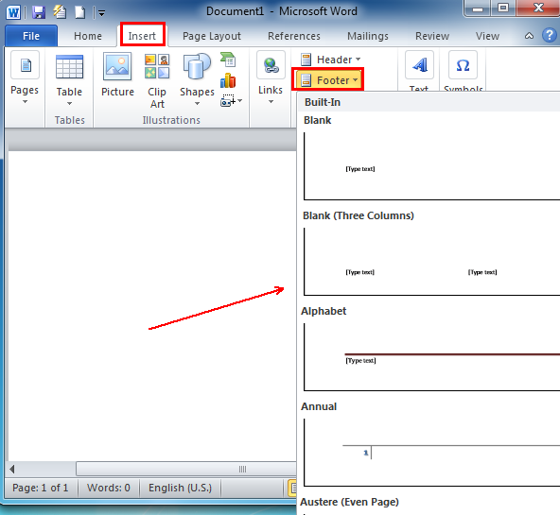
Open one word document, navigate to the "Insert" tab menu on the Ribbon of Microsoft Word 2007/2010/2013, under the Header & Footer options, you can easily see the "Footer" item at the middle. A Built-In dialog will appear by clicking Footer.
Practical No-07
Practical No-07
Presented by. Dr.Ronil K. Ahale

Slide 65
Using Language Tools
Practical No-07
Advanced word processors, such as Word, can automatically detect the language of the typed text and then use the spelling dictionary, grammar checker, and punctuation rules for that language.
Language tools are a convenient way to perform certain tasks automatically as you type, such as checking spelling and grammar.
Presented by. Dr.Ronil K. Ahale
Presented by. Dr.Ronil K. Ahale
Notes:
Advanced word processors, such as Word, can automatically detect the language of the typed text and then use the spelling dictionary, grammar checker, and punctuation rules for that language. This is a convenient way to perform certain tasks automatically as you type, such as checking spelling and grammar. Advanced word processors can support many languages, such as Chinese, English, French, and Spanish.
Advanced word processors also help you to search for synonyms and variations of words by using the thesaurus. The thesaurus is a reference library for different words and their synonyms. Word also includes a built-in dictionary and a grammar and spelling checker feature that indicates a grammatical error or a misspelled word.
In addition, you can configure the AutoCorrect function in Word to automatically correct misspellings and grammatical errors as soon as you start typing the text. For example, AutoCorrect can be set up to automatically correct misspellings, such as teh for the.

Slide 66
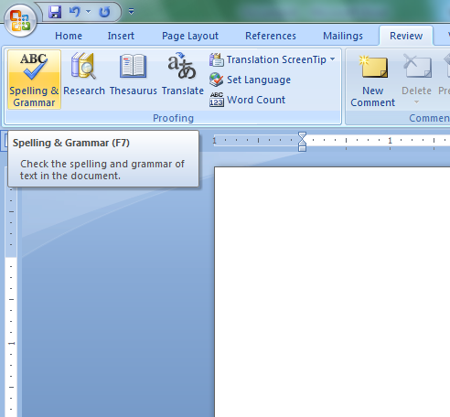

Spelling and Grammar Check
Practical No-07
Wavy red lines=spelling errors
Wavy green lines=grammatical mistakes
You can check the spelling and grammar of the entire document by clicking the Spelling and Grammar Button on the Review Tab.
Presented by. Dr.Ronil K. Ahale
Notes:
You can check the spelling and grammar of your document by using the tools that Word provides. In this demonstration, the document has been opened for you. Note that wavy red and green lines appear under some words and phrases. The red underlines indicate spelling mistakes and the green underlines indicate grammatical errors. Word-processors provide features that help you correct spelling mistakes and also suggest alternative words. You can check the spelling and grammar of the entire document by moving the insertion point to the top of the document and clicking the Spelling and Grammar button.

Slide 67
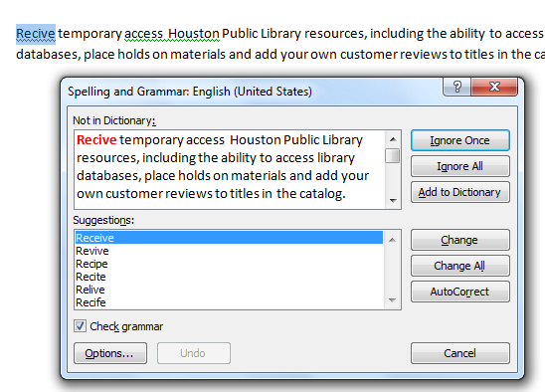
Spelling and Grammar Check
Practical No-07
Spelling suggestions
Change All
AutoCorrect
Grammar suggestions
Custom dictionary
Ignoring instances
Presented by. Dr.Ronil K. Ahale
Notes:
In the Spelling and Grammar dialog box, you can select the correct word from a list of proposed alternative spellings to correct the word and remove the wavy red underline that indicates a misspelled word.
By using the Change All option in the Spelling and Grammar dialog box, you can correct all instances of the misspelled word in a document. This saves the time required to correct individual incorrect entries.
You can add certain words to the AutoCorrect list. The next time you type the word incorrectly, Word automatically corrects it for you by referring to the AutoCorrect list entries. You can use this feature to automatically correct the words that you most commonly misspell.
The Spelling and Grammar feature also helps you check and correct grammatical mistakes in your document. You can view the recommended text in the Suggestion box, make the changes, and save it in your document.
You can add text from different languages in a built-in custom dictionary to avoid Word identifying them as misspellings. In this demonstration, you can include the Spanish word Sardana by using the Add to Dictionary button in the Spelling and Grammar dialog box.
Some words, such as the names of people, companies, trees, medicines, and acronyms, are not included in the built-in dictionary against which Word checks the spellings. For such words, you can choose to either ignore the suggestions or add such words to the custom dictionary to ensure that these words do not appear as misspelled words. In this demonstration, you want to ignore all instances of the word Pilar because it is the name of a hall.

Slide 68
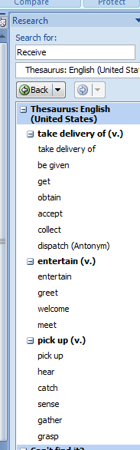
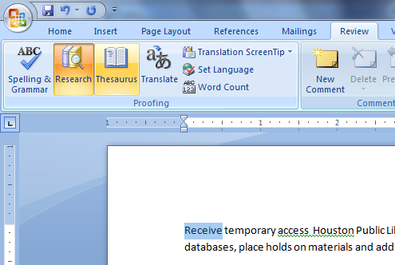
Language Tools: Thesaurus
Practical No-07
The Thesaurus Button lets you search for a word and presents a list of suggestions you can choose from.
The Thesaurus feature in Word lets you find alternatives for a word or phrase.
Presented by. Dr.Ronil K. Ahale
Notes:
You now want to find synonyms for the word “purpose”. You can use the Thesaurus feature in Word to find alternatives for a word or block of text. Word includes a thesaurus file that contains a list of synonyms for each word.
The Thesaurus task pane displays the Search for text box where you can type the word for which you require a synonym. Word then searches for synonyms from various resources and displays a list of probable alternatives. You can select the required word from this list. In this demonstration, you learned to work with the language tools provided in a word processor.

Slide 69
Inserting Table
Practical No-08
Perfrom the following step to draw a table.
click th table button present in the insert tab and select drow table from the drop-down line list mouse pointer cange in to pencil.
Drag the pencil to drow table borders,rows and colum when you are finshed drowing the table press the ESC key.
Presented by. Dr.Ronil K. Ahale

Slide 70
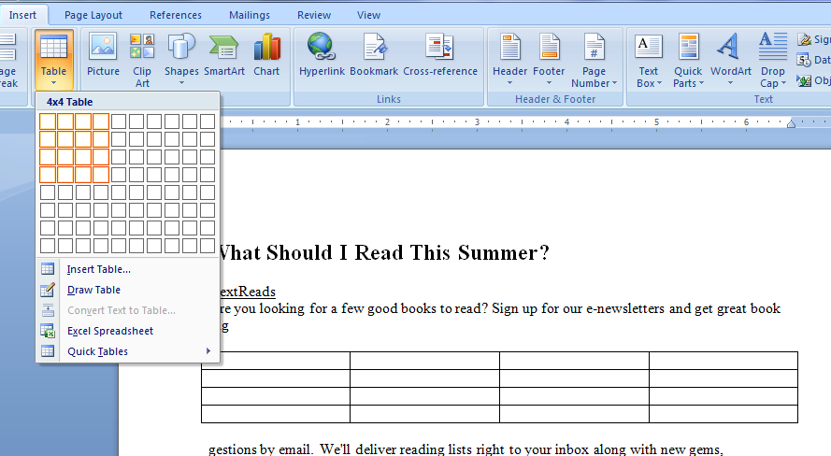
Tables and Pictures
Practical No-08
Presented by. Dr.Ronil K. Ahale
Notes:
In this example, we will insert a 4x7 table into a Sales Report document.
To begin inserting a table in this document, click the Table menu, point to Insert, and then click Table.
The Insert Table dialog box appears.
To set the number of columns for the table to 4, in the Number of columns box, click the Number of columns down arrow once.
To set the number of rows for the table to 7, click the Number of rows up arrow five times, and then click OK.
A table with 4 columns and 7 rows appears.
To select the first row of the table, point to the selection area to the left of the row, and click when the shape of the mouse pointer changes to an arrow pointing to the right.

Slide 71
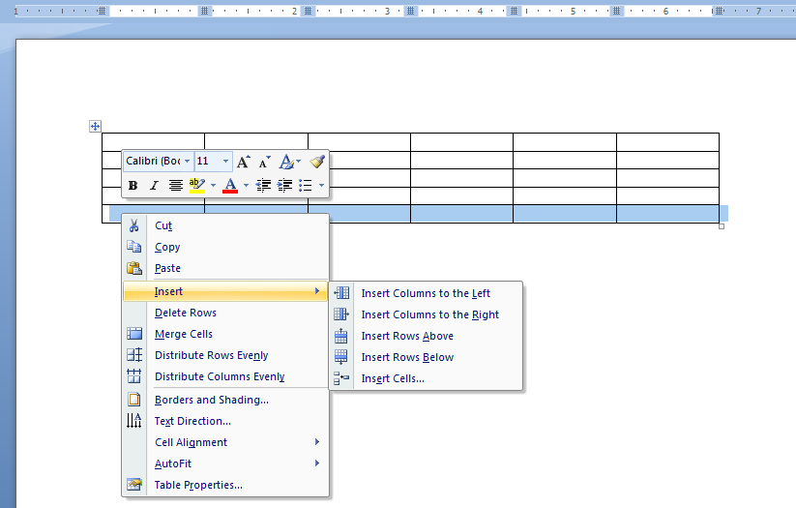
Tables and Pictures
Practical No-08
Presented by. Dr.Ronil K. Ahale
Notes:
A table with 4 columns and 7 rows appears.
To select the first row of the table, point to the selection area to the left of the row,
and click when the shape of the mouse pointer changes to an arrow pointing to the right.
You can also merge cells in a table. To combine the cells in the first row into a single cell,
click the Table menu, and then click Merge Cells.
To insert a title for the table in the first row, press SPACEBAR to have the title typed for you.
To enter text in the first cell of the second row and move the insertion point to the next cell,
click in the cell, press SPACEBAR, and wait for text to be typed for you, and then press the TAB key.
To insert the remaining entries in the table, press SPACEBAR to have the entries typed for you.
To add two rows, drag down the selection area to the left of the sixth and seventh rows to select the rows,
click the Table menu, point to Insert, and then click Rows Below.
To delete the second last row, point to the selection area to the left of the row and click when the shape of the mouse pointer changes to an arrow pointing to the right. Next, click the Table menu, point to Delete, and then click Rows.

Slide 72
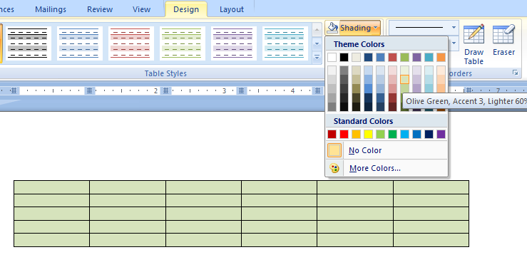
Tables and Pictures
Practical No-08
Presented by. Dr.Ronil K. Ahale
Notes:
After inserting a table, you can also add borders and shading to it. To start customizing the table borders, on the Format menu,
click Borders and Shading, then in the Borders tab, under Setting, click the All icon.
To change the line style of the border, in the Style box, click the Down scroll arrow, and then click the double-line style.
To change the color of the border, click the Color box, click the indicated blue in the color palette, and then click OK.
To start shading the cells of the table, on the Format menu, click Borders and Shading, and then in the Borders and Shading dialog box, click the Shading tab.
To select a color for the shading, in the Fill area of the Borders and Shading dialog box, click the indicated yellow in the color palette, and then click OK.

Slide 73
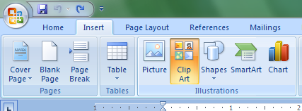
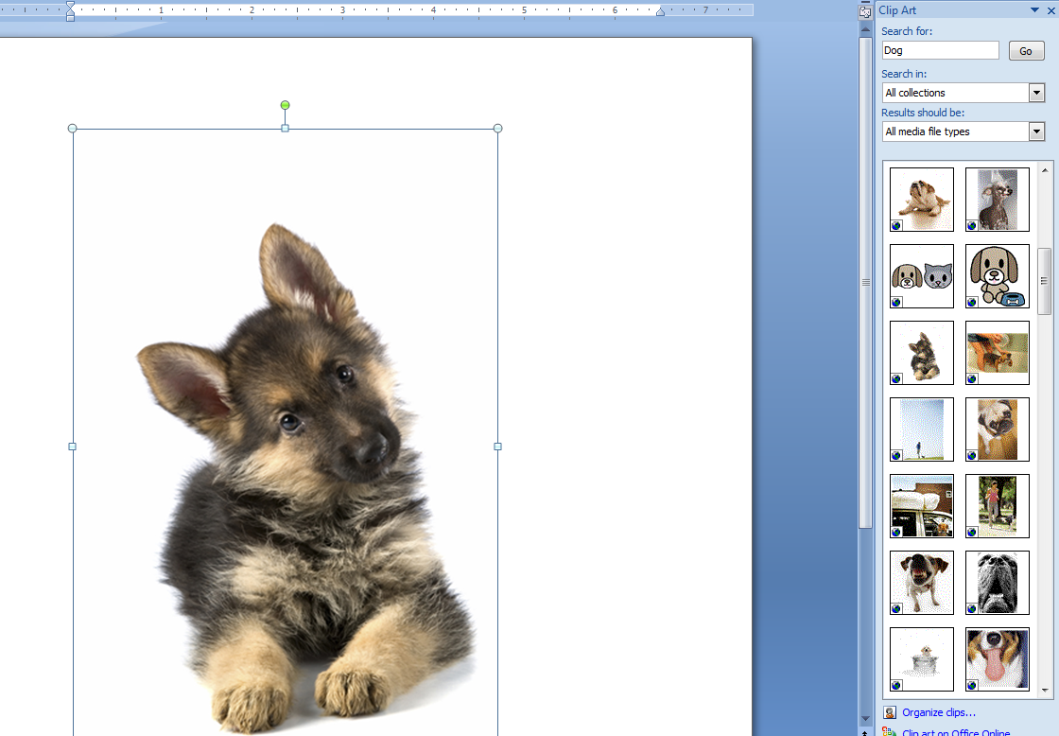
Tables and Pictures
Practical No-08
Presented by. Dr.Ronil K. Ahale
Notes:
You can also insert a picture, such as the logo of a company, in a document. To start inserting a logo, place the insertion point below the heading,
School of Fine Art, then click the Insert menu, point to Picture, and then click From File.
To insert the logo, on the Places bar of the Insert Picture dialog box, double-click School of Fine Art, and then double-click logo.
You can also insert pictures from clip art that is available with Word.
To start inserting a clip art image, click the Down scroll arrow once, then click the Insert menu, point to Picture, and then click Clip Art.
To search for an image corresponding to reports, in the Clip Art task pane, click in the Search for box, then press SPACEBAR to have the keyword typed for you, and then click GO.
To select and insert a clip art image, in the Clip Art task pane, click the indicated drawing, and then click the Close button on the title bar of the task pane.

Slide 74
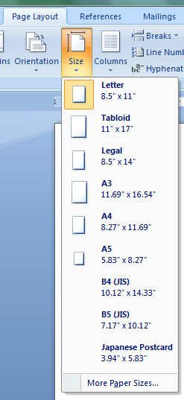
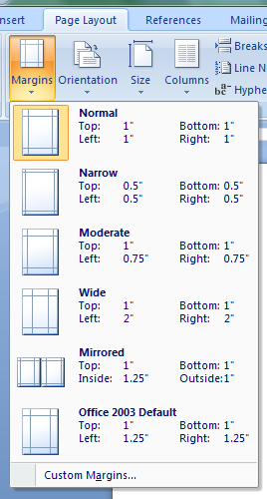
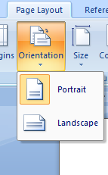
Page Layout
Practical No-08
Presented by. Dr.Ronil K. Ahale
Notes:
After inserting a chart in the document, you now want to print it. Before printing, you want to view the orientation of the page and make changes to ensure that the text fits in one page. To start changing the page orientation, click the File menu, and then click Page Setup.
To orient the page widthwise rather than the usual lengthwise, under Orientation in the Page Setup dialog box, click Landscape, and then click OK.
To change the paper size to fit the text, click the File menu, click Page Setup, and then click the Paper tab.
Click the Paper size arrow, click Legal, and then click OK.

Slide 75
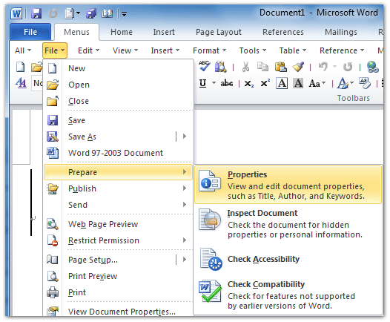
Practical No-09
Click the Menus tab;
Click the File drop down menu;
Click the Prepare item;
Then you will view the Properties item.
This Properties item will add the Document0
Properties pane above Word workspace.
Presented by. Dr.Ronil K. Ahale

Slide 76
Questions
Presented by. Dr.Ronil K. Ahale

